Slide 1
Planning Tools and Techniques
Chapter
4(remaining)
© 2007 Prentice Hall, Inc.
All rights reserved.

Slide 2
Assessing the Environment
Environmental Scanning
  The screening of large amounts of information to anticipate and interpret change in the environment.
© 2007 Prentice Hall, Inc. All rights reserved.
9–<number>

Slide 3

Assessing the Environment (cont’d)
Environmental Scanning (cont’d)
  Global Scanning
    Screening a broad scope of information on global forces that might affect the organization.
    Has value to firms with significant global interests.
    Draws information from sources that provide global perspectives on world-wide issues and opportunities.
© 2007 Prentice Hall, Inc. All rights reserved.
9–<number>

Slide 4

Assessing the Environment (cont’d)
Forecasting
  The part of organizational planning that involves creating predictions of outcomes based on information gathered by environmental scanning.
    Facilitates managerial
    decision making.
    Is most accurate in
    stable environments.
© 2007 Prentice Hall, Inc. All rights reserved.
9–<number>

Slide 5

Assessing the Environment (cont’d)
Forecasting Techniques
  Quantitative forecasting
    Applying a set of mathematical rules to a series of hard data to predict outcomes (e.g., units to be produced).
  Qualitative forecasting
    Using expert judgments and opinions to predict less than precise outcomes (e.g., direction of the economy).
Collaborative Planning, Forecasting, and Replenishment (CPFR) Software
  A standardized way for organizations
  to use the Internet to exchange data.
© 2007 Prentice Hall, Inc. All rights reserved.
9–<number>

Slide 6
Exhibit 9–1 Forecasting Techniques
Quantitative
  Time series analysis
  Regression models
  Econometric models
  Economic indicators
  Substitution effect
Qualitative
  Jury of opinion
  Sales force composition
  Customer evaluation
© 2007 Prentice Hall, Inc. All rights reserved.
9–<number>

Slide 7
Making Forecasting More Effective
Use simple forecasting methods.
Compare each forecast with its corresponding “no change” forecast.
Don’t rely on a single forecasting method.
Don’t assume that the turning points in a trend can be accurately identified.
Shorten the time period covered by a forecast.
Remember that forecasting is a developed managerial skill that supports decision making.
© 2007 Prentice Hall, Inc. All rights reserved.
9–<number>

Slide 8

Benchmarking
The search for the best practices among competitors and noncompetitors that lead to their superior performance.
By analyzing and copying these practices, firms can improve their performance.
© 2007 Prentice Hall, Inc. All rights reserved.
9–<number>

Slide 9
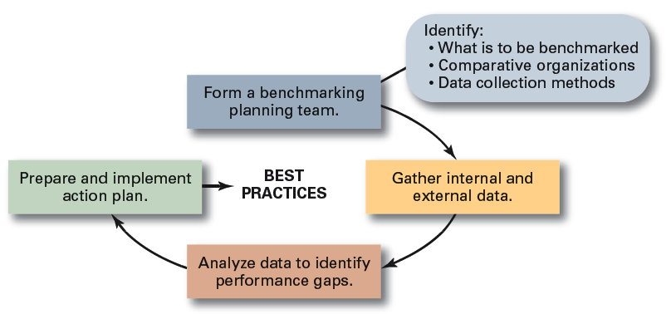
Exhibit 9–2 Steps in Benchmarking
Source: Based on Y.K. Shetty, “Aiming High: Competitive Benchmarking for Superior Performance,” Long Range Planning. February 1993, p. 42.
© 2007 Prentice Hall, Inc. All rights reserved.
9–<number>

Slide 10
Allocating Resources
Types of Resources
  The assets of the organization
    Financial: debt, equity, and retained earnings
    Physical: buildings, equipment, and raw materials
    Human: experiences, skills, knowledge, and competencies
    Intangible: brand names, patents, reputation, trademarks, copyrights, and databases
© 2007 Prentice Hall, Inc. All rights reserved.
9–<number>

Slide 11

Allocating Resources: Budgeting
Budgets
  Are numerical plans for allocating resources (e.g., revenues, expenses, and capital expenditures).
  Are used to improve time, space, and use of material resources.
  Are the most commonly used
  and most widely applicable
  planning technique for
  organizations.
© 2007 Prentice Hall, Inc. All rights reserved.
9–<number>

Slide 12
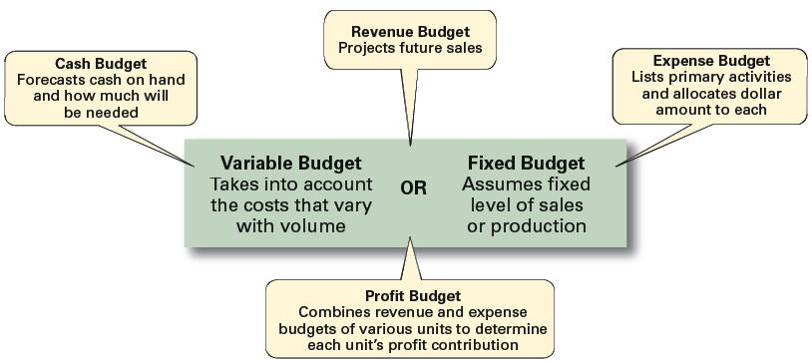
Exhibit 9–3 Types of Budgets
Source: Based on R.S. Russell and B.W. Taylor III. Production and Operations Management (Upper Saddle River, NJ: Prentice Hall, 1995), p. 287.
© 2007 Prentice Hall, Inc. All rights reserved.
9–<number>

Slide 13
Exhibit 9–4 Suggestions for Improving Budgeting
Collaborate and communicate.
Be flexible.
Goals should drive budgets—budgets should not determine goals.
Coordinate budgeting throughout the organization.
Use budgeting/planning software when appropriate.
Remember that budgets are tools.
Remember that profits result from smart management, not because you budgeted for them.
© 2007 Prentice Hall, Inc. All rights reserved.
9–<number>

Slide 14

Allocating Resources: Scheduling
Schedules
  Plans that allocate resources by detailing what activities have to be done, the order in which they are to be completed, who is to do each, and when they are to be completed.
  Represent the coordination of various activities.
© 2007 Prentice Hall, Inc. All rights reserved.
9–<number>

Slide 15
Allocating Resources: Charting
Gantt Chart
  A bar graph with time on the horizontal axis and activities to be accomplished on the vertical axis.
  Shows the expected and actual progress of various tasks.
© 2007 Prentice Hall, Inc. All rights reserved.
9–<number>

Slide 16
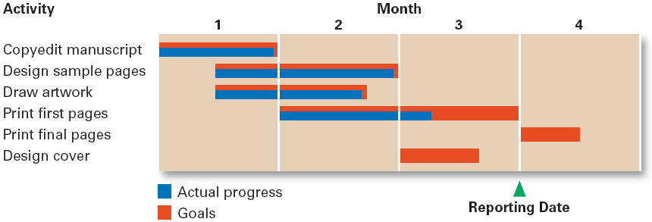
Exhibit 9–5 A Gantt Chart
© 2007 Prentice Hall, Inc. All rights reserved.
9–<number>

Slide 17
Contemporary Planning Techniques
Project
  A one-time-only set of activities that has a definite beginning and ending point time.
Project Management
  The task of getting a project’s activities done on time, within budget, and according to specifications.
    Define project goals
    Identify all required activities, materials, and labor
    Determine the sequence of completion
© 2007 Prentice Hall, Inc. All rights reserved.
9–<number>

Slide 18
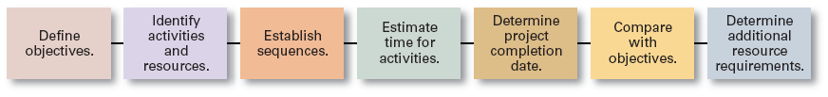
Exhibit 9–13 Project Planning Process
Source: Based on R.S. Russell and B.W. Taylor III, Production and Operations Management (Upper Saddle River, NJ: Prentice Hall, 1995), p. 287.
© 2007 Prentice Hall, Inc. All rights reserved.
9–<number>

Slide 19
Contemporary Planning Techniques (cont’d)
Scenario
  A consistent view of what the future is likely to be.
Scenario Planning
  An attempt not try to predict the future but to reduce uncertainty by playing out potential situations under different specified conditions.
Contingency Planning
  Developing scenarios that allow managers determine in advance what their actions should be should a considered event actually occur.
© 2007 Prentice Hall, Inc. All rights reserved.
9–<number>

Slide 20
Exhibit 9–14 Preparing for Unexpected Events
Identify potential unexpected events.
Determine if any of these events would have early indicators.
Set up an information gathering system to identify early indicators.
Have appropriate responses (plans) in place if these unexpected events occur.
© 2007 Prentice Hall, Inc. All rights reserved.
9–<number>
Source: S. Caudron, “Frontview Mirror,” Business Finance, December 1999, pp. 24–30.

